Slide 1
Understanding and critique on ChatGPT
Muvvala N V Sai Gurudeep , SE20UARI103
Rama Sai Pavan Kotipalli , SE20UARI123
Sreevalli Yetisetti , SE20UARI148
Anushree Singhal , SE20UARI178
under the guidance of
Prof. Avinash Arun Chauhan,
Assoc. Prof, MEC
Notes:
1

Slide 2
Problem Statement
How does ChatGPT's ability to bluff or lie challenge the traditional notion of reliability and predictability associated with computers?
What are the underlying mechanisms and architecture of ChatGPT that enable it to mimic human behavior?
How does ChatGPT blur the boundaries between machine intelligence and human consciousness, and what profound questions does it raise in this regard?

Slide 3
Motivation
The project aims to evaluate ChatGPT's ability to accurately recognize signs of depression and provide appropriate support.
Exploring human-machine interaction: The project seeks to explore the concept of the Turing test and the extent to which ChatGPT can mimic human behavior. This exploration can provide insights into how humans perceive and trust AI technologies.

Slide 4
Related Work
Can GPT-3 Pass a Writer's Turing Test?
This research paper examines whether GPT-3 can generate human-like written responses in various domains. It finds that while GPT-3 produces impressive outputs, it often lacks deep understanding and can generate contextually inconsistent or factually incorrect responses. Additionally, GPT-3 tends to be verbose and tangential at times, reducing coherence.
GPT-3: What is it Good For?
This research paper examines the strengths and limitations of GPT-3 in practical applications. It acknowledges GPT-3's impressive language generation abilities but focuses on understanding its specific contexts of excellence. The authors conduct experiments in various domains and identify where GPT-3 performs exceptionally well compared to other models. However, the paper highlights the limitation of GPT-3 in terms of factual accuracy and advises caution in relying on it for precise information in fields like medicine or law.

Slide 5
Timeline of Activities
file:///D:/Gurudeep/2%20MEC/Subjects/3%20Year/2%203rd%20Year%20Project/graphs/timeline.html

Slide 6
Overview of Data Sets
The Reddit Depression Dataset contains posts from users who have expressed their experiences or discussions related to depression on the Reddit platform. The dataset aims to capture insights into the thoughts, emotions, and experiences of individuals dealing with depression.
The size of the dataset can vary depending on the specific version or source of the dataset. Without specific information on the version or specific dataset you are referring to, I can provide a general description. The Reddit Depression Dataset typically consists of a substantial number of posts, often ranging from thousands to tens of thousands or more.
Regarding the attributes in the input dataset, here are some common attributes you might find in the Reddit Depression Dataset:
Post ID: A unique identifier for each post.
User ID: A unique identifier for each user who made the post.
Title: The title or heading of the post.
Text: The main text or content of the post, where users express their thoughts and experiences related to depression.

Slide 7
Algorithm used
Human Annotation and Find Major Label:
Annotate the dataset by assigning major labels or categories to each post based on the content or theme.
Determine the primary or most relevant label that represents the post's content.
Get CHATGPT Responses and Classifications with Probabilities:
Utilize CHATGPT to generate responses or classifications for the posts in the dataset.
Retrieve the classifications along with the corresponding probabilities assigned by CHATGPT.
Create Annotator Guidelines and Inter-Annotator Agreement:
Develop guidelines or instructions for annotators to follow when labeling the dataset.
Ensure consistency and clarity in the annotation process.
Calculate Cohen's Kappa Score:
Assess the inter-annotator agreement by calculating Cohen's Kappa score.
Measure the level of agreement among multiple annotators in assigning the major labels.
Compare True and False Labels:
Compare the true major labels assigned through human annotation with the labels generated by CHATGPT.
Identify the instances where the classifications provided by CHATGPT align with or differ from the true labels.
Analyze the Results:
Evaluate the performance of CHATGPT in classifying the posts.
Examine the level of agreement between human annotations and CHATGPT's classifications.
Assess the accuracy, precision, recall, and other metrics to measure the effectiveness of CHATGPT.
Make Conclusions:
Draw conclusions based on the comparison and analysis of true and false labels.
Identify areas of agreement or discrepancy between human annotation and CHATGPT's classifications.
Determine the trustworthiness and reliability of CHATGPT's responses and classifications for the given dataset.

Slide 8
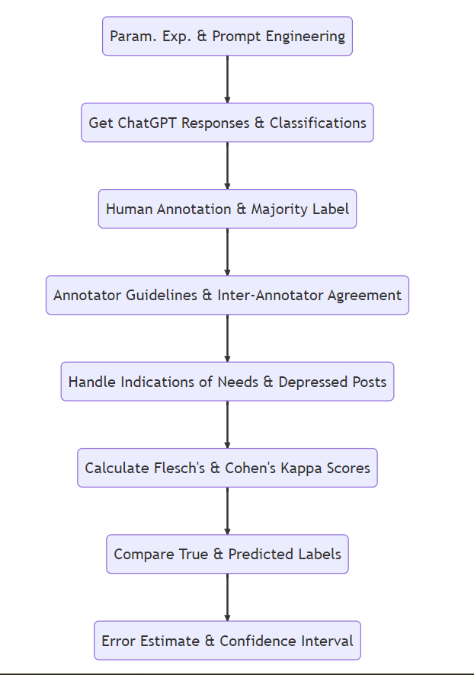
Implementation Steps

Slide 9
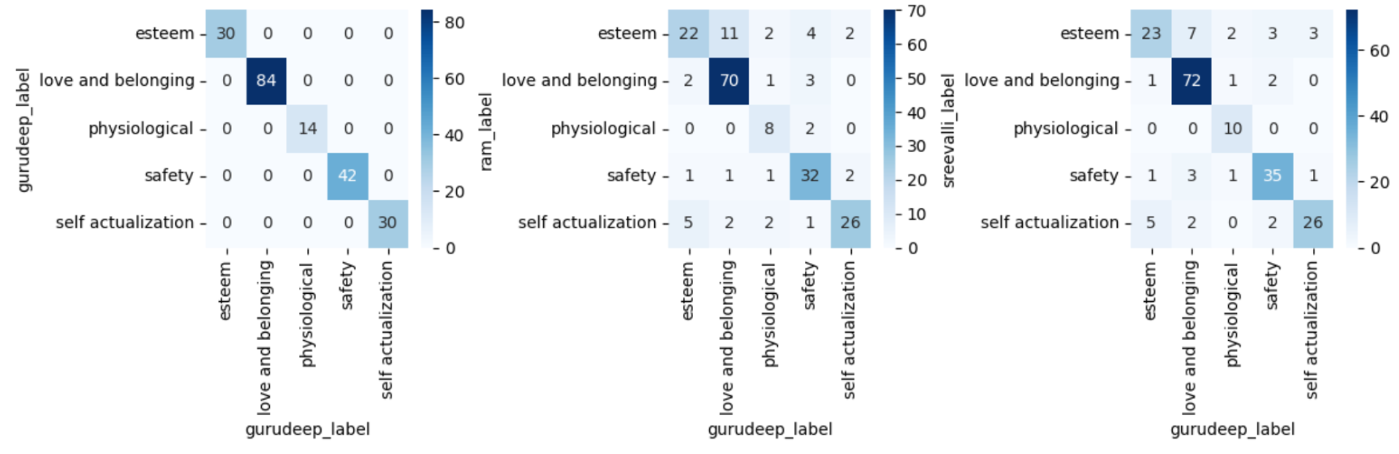
Results
Annotations Agreement Details

Slide 10
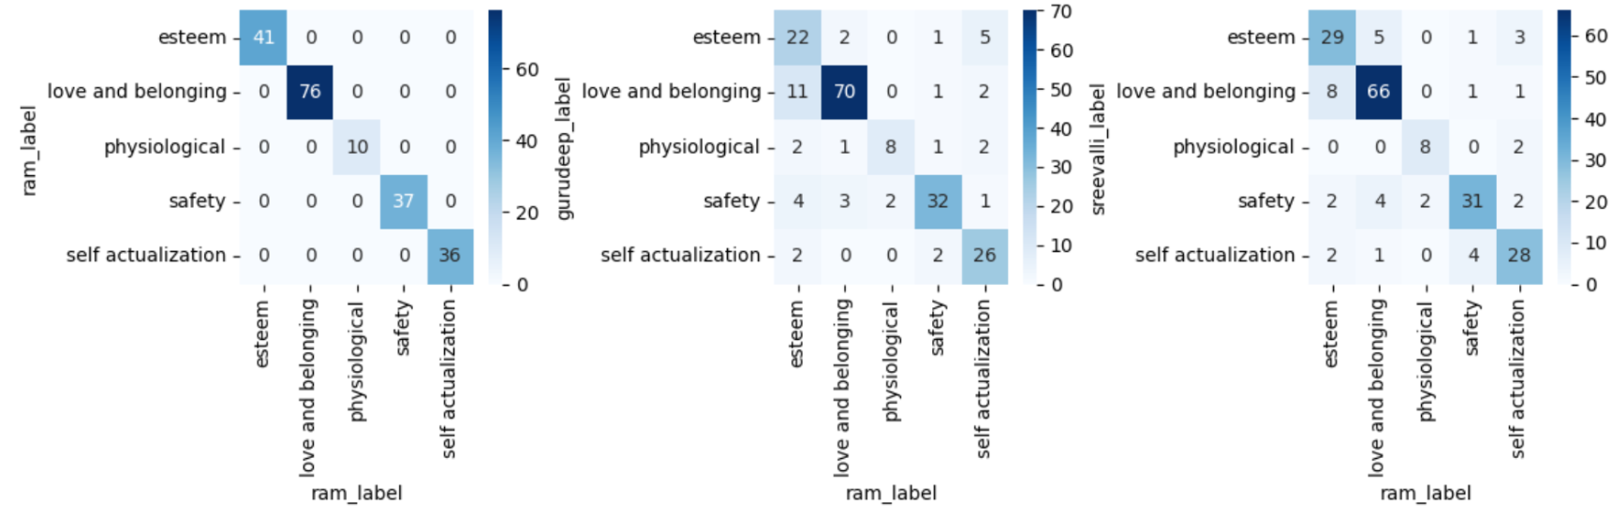
Results
Annotations Agreement Details (for 200 samples)
Fleiss' kappa: 0.7435 (substantial agreement) Ram and Sreevalli 0.7449
Ram and Gurudeep 0.7163
Sreevalli and Gurudeep 0.770
We use Anushree labels as tie breaker if had any issues during annotation

Slide 11
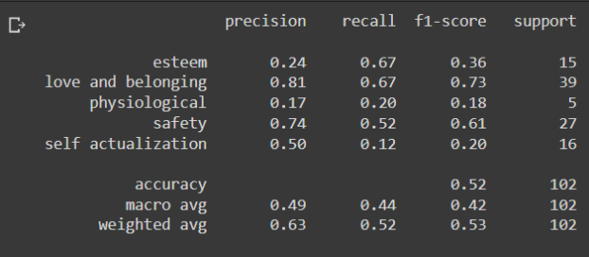
Results
Classification Report

Slide 12
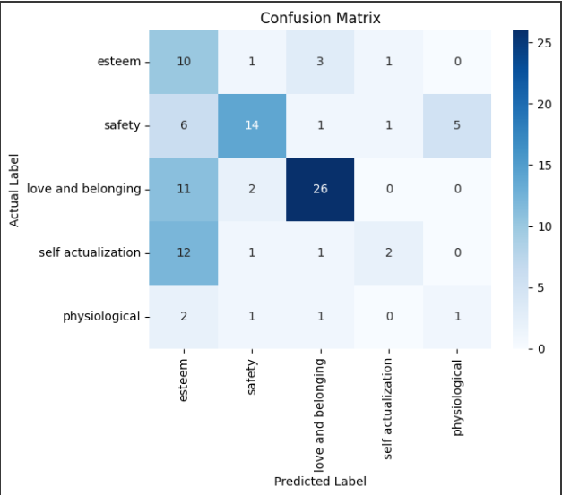
Results
Confusion Matrix

Slide 13
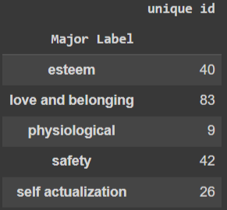
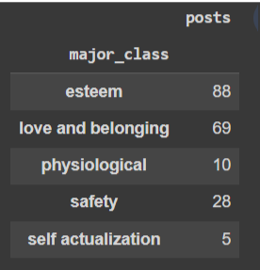
Results
Number of Posts Labelled vs Number of Posts in each category marked by CHATGPT

Slide 14
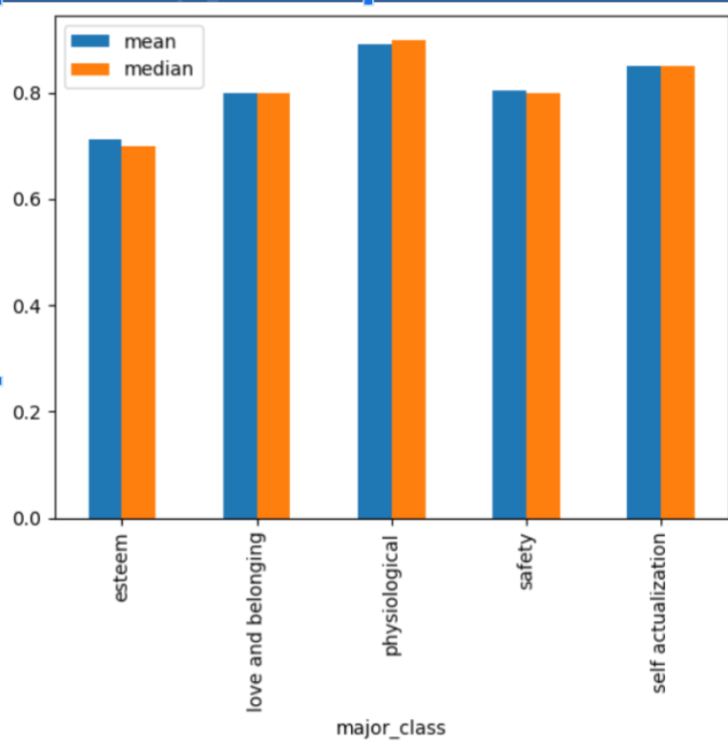
Results
Confidence on my Model: lower=0.486, upper=0.624
Confidence of my Model

Slide 15
References
https://www.zdnet.com/article/chatgpt-and-more-what-ai-chatbots-mean-for-the-future-of-cybersecurity/
https://www.theverge.com/21346343/gpt-3-explainer-openai-examples-errors-agi-potential
https://www.vox.com/future-perfect/21355768/gpt-3-ai-openai-turing-test-language
https://algowriting.medium.com/gpt-3-temperature-setting-101-41200ff0d0be
https://arxiv.org/pdf/2303.15056v1.pdf
https://www.oreilly.com/radar/what-are-chatgpt-and-its-friends/
https://www.reddit.com/r/GPT3/comments/o1qvk7/are_tokens_syllables/
https://jalammar.github.io/how-gpt3-works-visualizations-animations/
https://hollygrimm.com/gpt3musings
https://www.gwern.net/GPT-3#bpes
https://arxiv.org/pdf/1508.07909.pdf
https://towardsdatascience.com/exploring-token-probabilities-as-a-means-to-filter-gpt-3s-answers-3e7dfc9ca0c
https://deepchecks.com/model-confidence-and-how-it-helps-model-validation/
https://machinelearningmastery.com/confidence-intervals-for-machine-learning/

Slide 16
Thanks !
Q&A
Notes:
16

